Slide 1
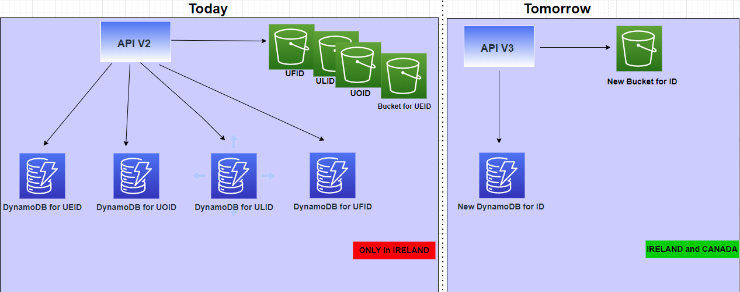
Difference between V2 and V3 : Infrastructure

Slide 2
Interaction between Orchestra and SAP sharing Eyecloud ID : Issue
Share the UOID with SAP
Orchestra
4
SAP
POST a Document with the UOID gotten from Orchestra
UOID not present, Impossible to store document
8
5
Get back UOID
from Eyecloud
3
1
Ask UOID to Eyecloud
Eyecloud API V3
Eyecloud API V2
UOID not present
Check if ID is present before posting Document on It
Save the UOID in DynamoDB
7
6
2
UEID
UFID
ULID
UOID
ECID
S3 bucket
S3 bucket
S3 bucket
S3 bucket
S3 bucket
DynamoDB
DynamoDB
DynamoDB
DynamoDB
DynamoDB

Slide 3
Interaction between Orchestra and SAP sharing Eyecloud ID : Solution
Share the ECID with SAP
Orchestra
4
SAP
Get back ECID
from Eyecloud
3
1
Ask ECID to Eyecloud
5
POST a Document with the ECID gotten from Orchestra
Eyecloud API V3
2
Save the ECID in DynamoDB
ECID
S3 bucket
DynamoDB

